Slide 1


Slide 2
AI-Opening Case Study Artificial Intelligence Supporting Economic Re-Opening Efforts: A Case Study Using Predictive Analytics for Risk Profiling of Covid-19 Patients
By:
Moaven Razavi, Ph.D.
Heller School, Brandeis University
April 2020

Slide 3
Why are the predictive analytics models are so important?
Identifying the at-risk populations
For re-opening efforts:
Making sure they stay home
OR
If employed being considered by the government to pick up their salary until a vaccine is made available to them
Applications of such models:
Re-opening efforts in the US and around the world
If a vaccine is made available prioritizing the at-risk population for early reception of the vaccine
More accurate estimates of mortality and burden of disease in other prediction models

Slide 4
Clinical Data Source
Synthetic data created based on a real sample
Number of patients over 370,000
Cohort: Pts tested positive with Covid-19 in the US
Variables: over 250 variables including demographics and health conditions

Slide 5
Analytic approach step-by-step guide
Run your predictive analytics (AI based or for Heller Logistic models)
Create analytic file out of the clinical data
Digest and make sense of your model results
Measure efficiency of your model by creating false/true positive/negative quadrant
Use text mining methods to visualize your findings
Executive Summary slide deck & a Technical Report

Slide 6
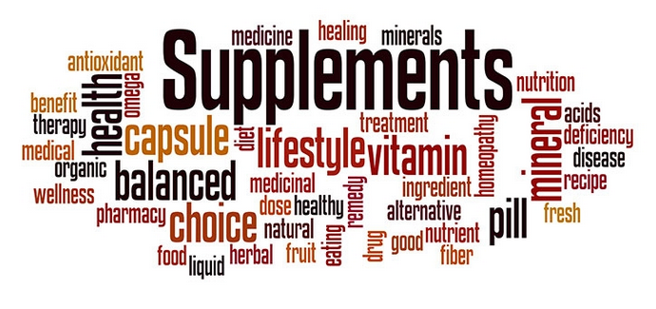
Use the best of text mining and other techniques to make sense of the vast amount of the predictors/features you get from your model
Source for the graphics: https://www.nutraceuticalsworld.com/blog/blogs-and-guest-articles/2018-12-03/text-mining-a-tool-to-analyze-consumer-health-questions/

Slide 7
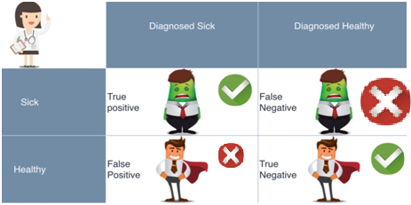
Predictive Analytics: Testing and Error Metrics and Performance Measurement
Source: https://www.youtube.com/watch?v=aDW44NPhNw0

Slide 8
Cross Validation with other scientific sources
Examine your results against that of the CDC and others
https://www.cdc.gov/coronavirus/2019-ncov/need-extra-precautions/people-at-higher-risk.html

